Slide 1

What is Javascript?
javaScript is a scripting or programming language that allows you to implement complex features on web pages — every time a web page does more than just sit there and display static information for you to look at — displaying timely content updates, interactive maps, animated 2D/3D graphics, scrolling video jukeboxes, etc.

Slide 2
So what can it really do?

Slide 3
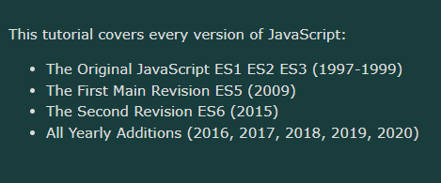
History Of Javascript

Slide 4
Why do We learn Javascript?

Slide 5

How to run a js code in your browser

Slide 6
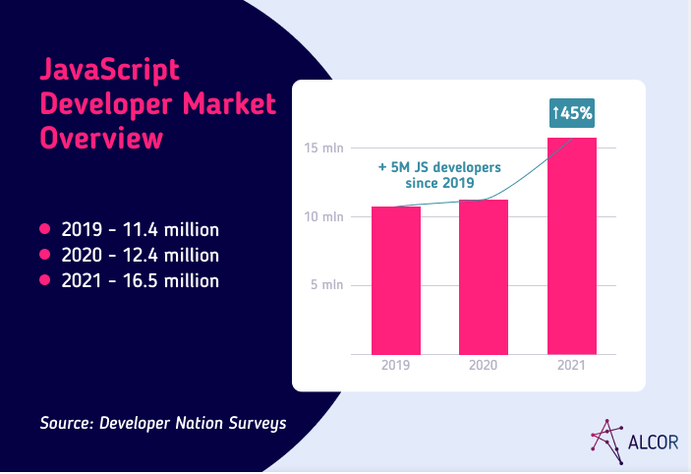
JavaScript Global Market Trend

Slide 7
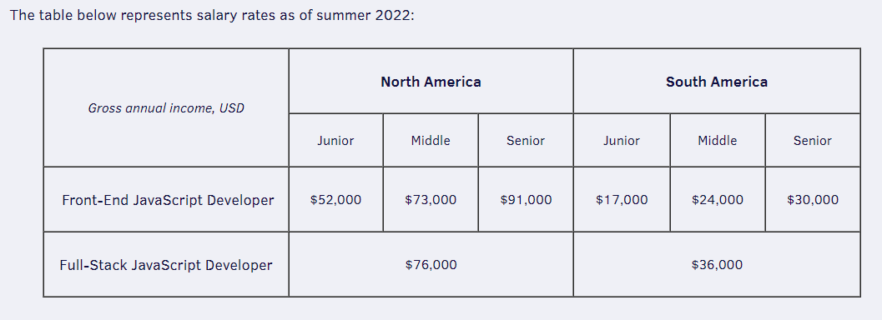
America Market Demand

Slide 8
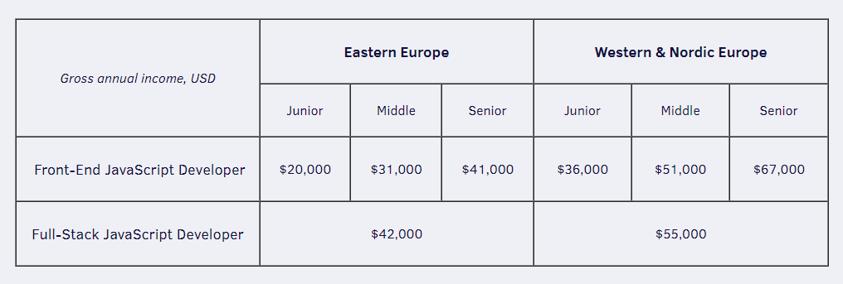
America Market Demand

Slide 9
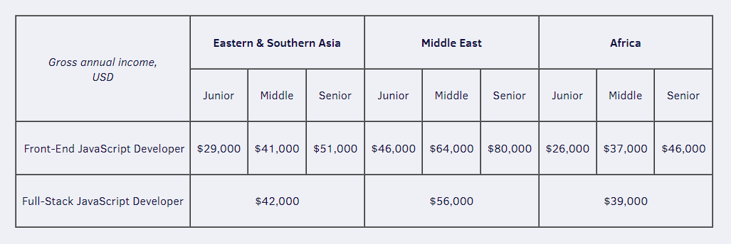
Asia Market Demand

Slide 10

Brendan Eich
JavaScript was invented by Brendan Eich in 1995. It was developed for Netscape 2, and became the ECMA-262 standard in 1997. After Netscape handed JavaScript over to ECMA, the Mozilla foundation continued to develop JavaScript for the Firefox browser. Mozilla's latest version was 1.8

